Slide 1


Search for Type-III Seesaw Heavy Fermions With Multilepton Final States using 2.3 fb^{–1} of √s = 13 TeV proton–proton Collision Data
Ph. D. Defense
Peter Thomassen
April 5, 2016

Slide 2
Outline
Introduction
Theoretical Overview
Experimental Apparatus
Datasets and Event Selection
Search Strategy
Background Estimation
Systematic Uncertainties
Results

Slide 3
Bio
Bachelor’s and Master’s program at Würzburg University (Germany)
Participated in exchange year to Rutgers during 1st year of Master’s
full switch to Rutgers after exchange year
Master’s degree awarded in 2012 (SUSY search at √s = 7 TeV)
Enrolled as a Ph. D. student at Rutgers
qualifiers along with Master’s defense
Received financial support from
sdw (Foundation of German Business)
DAAD (German Academic Exchange Service)
NSF
Rutgers

Slide 4
Contributions during LHC Run I
Involved with the Rutgers Multilepton search
Very broad, generic search with interpretations mostly in SUSY
Contributed code for statistical interpretation
Resulted in 6 papers
various SUSY and Heavy Higgs models
t → cH measurement
Results were combined with other research groups
Acted as a contact person for the combination
Also participated in PLT detector development
Pixel Luminosity Telescope: a luminometer for CMS, installed by now

Slide 5
Preparation for LHC Run II
Wrote new software framework (together with Matt Walker)
computes all quantities that are of interest for the analysis
categorizes event into search regions
estimates background in each region
produces output files used for statistical interpretation
Used the new software framework to
reproduce Run I results
refine background estimation methods used during Run I, anticipating Run II needs
Rest of the talk focused on work for Run II Seesaw result

Slide 6
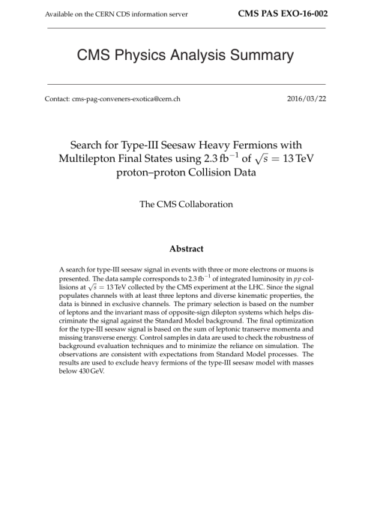
Motivation
While the Standard Model (SM) describes most particle phenomena with remarkable accuracy, some issues remain
Example: Neutrino mass is small, but not zero
Extensions to the SM have been proposed to remedy these issues
The “seesaw mechanism” explains why neutrinos are so light by postulating massive partner particles (which decay to SM particles)
This search looks for evidence of these heavy particles in final states with at least 3 leptons
It was announced by CMS on March 22, 2016

Slide 7
Outline
Introduction
Theoretical Overview
Experimental Apparatus
Datasets and Event Selection
Search Strategy
Background Estimation
Systematic Uncertainties
Results

Slide 8
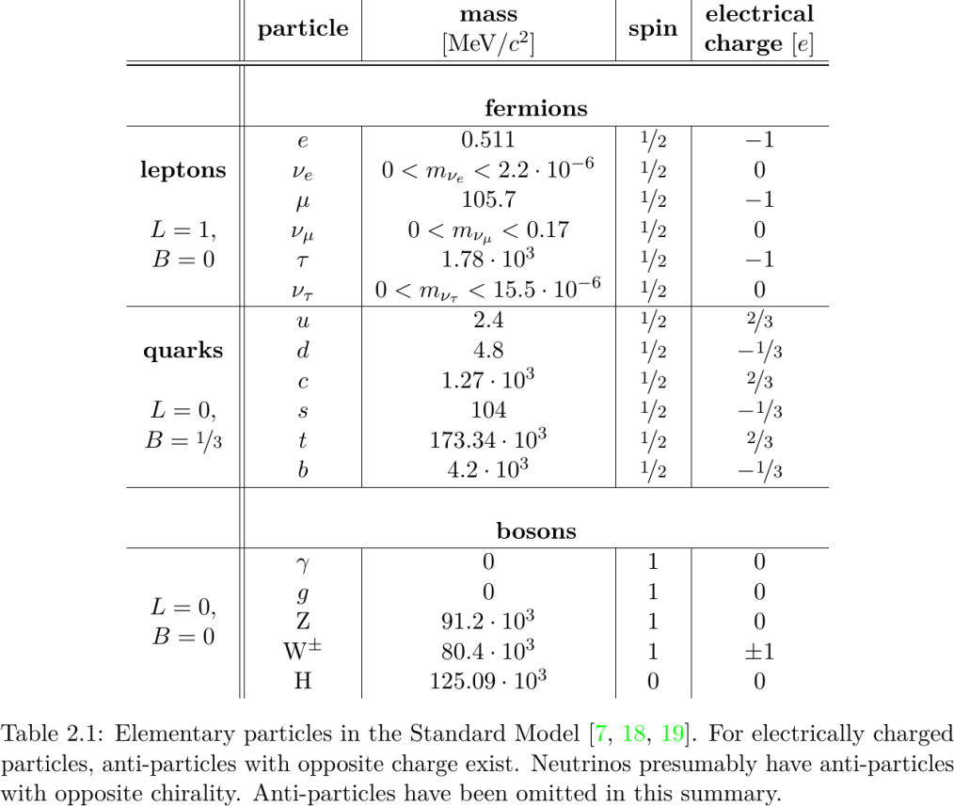
Standard Model of Particle Physics
Quantum Field Theory of elementary particles
leptons, quarks, bosons
… and their interactions
electromagnetism
weak interaction
strong interaction

Slide 9
Shortcomings of the Standard Model
While remarkably successful, the following issues remain:
The SM does not describe gravity at all.
The SM does not explain Dark Matter.
The Higgs boson mass is expected around 10¹⁵ GeV within the SM, but it is in fact on the electroweak scale (125 GeV). This is called the Hierarchy Problem.
This very small neutrino mass is not motivated within the SM.
The last issue may be resolved by extending the SM with additional heavy fermions that couple to leptons (“seesaw mechanism”)
The purpose of this search is to look for such seesaw signal with ≥ 3 e/μ

Slide 10
Seesaw Mechanism
Small Majorana mass is mediated by massive partners with Yukawa copulings to leptons through Higgs
Type I: Invokes a right-handed singlet state
Type II: Scalar triplet state
Type III: Implements particle mass for fermionic SU(2) triplet
Heavy Dirac charged leptons: Σ±
Heavy Majorana neutral lepton: Σ⁰
C. Biggio and F. Bonnet, “Implementation of the type III seesaw model in FeynRules /MadGraph and prospects for discovery with early LHC data”, Eur. Phys.J. C (2012) 72:1899, doi:10.1140/epjc/s10052-012-1899-z

Slide 11
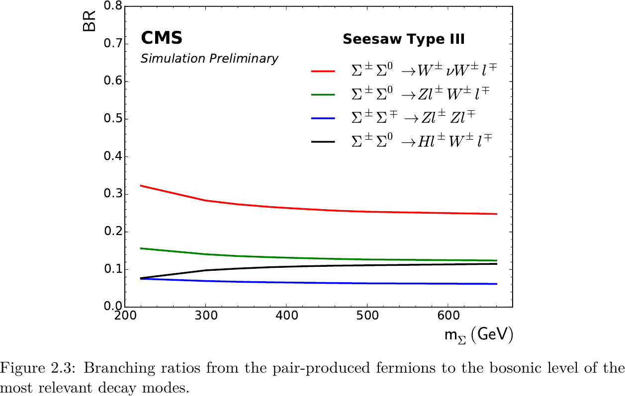
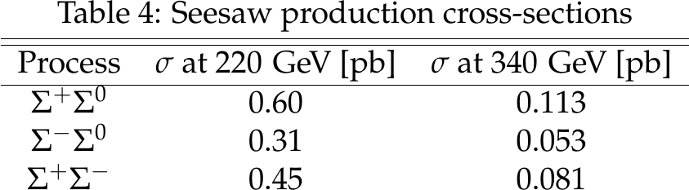
Phenomenology
Heavy fermions are produced in pairs
Σ⁺Σ⁰, Σ⁻Σ⁰, Σ⁺Σ⁻
Decay modes (per fermion):
Σ± → W±υ, Σ± → Z l±, Σ± → H l±
Σ⁰ → W±l±, Σ⁰ → Zυ, Σ⁰ → Hυ
We consider all 27 channels, combining production + decays

Slide 12
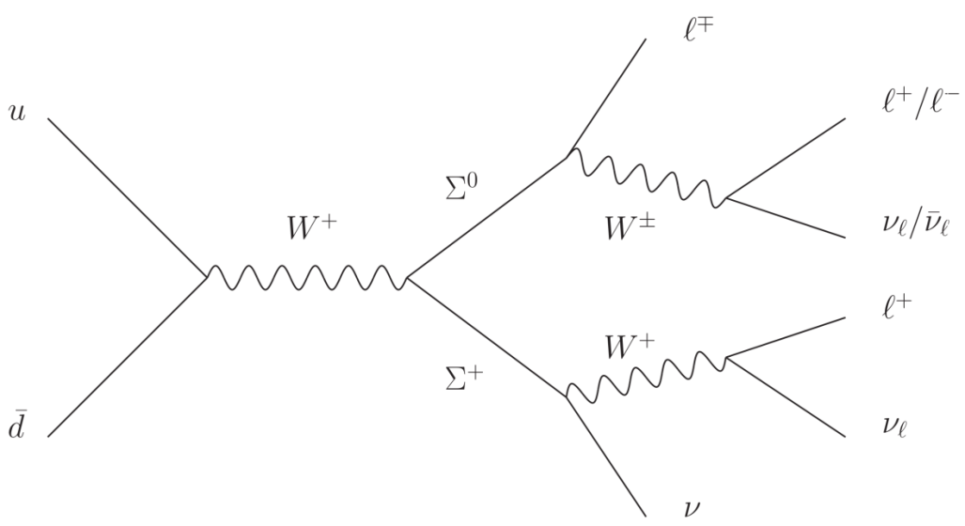
Phenomenology (II)
How do multileptons (≥ 3) arise?
Most modes produce a lepton directly
W, Z, H yield ≥ 2 additional leptons
Leptons might be on or off Z
If W’s are present, some MET is expected
We don’t expect b-jets or very high hadronic activity

Slide 13
Outline
Introduction
Theoretical Overview
Experimental Apparatus
Datasets and Event Selection
Search Strategy
Background Estimation
Systematic Uncertainties
Results

Slide 14
Large Hadron Collider
Operated by CERN
Located 100 m underground near Geneva (Switzerland)
26.7 km circumference
~ 1200 superconducting magnets → field of 8.33 T
used to accelerate protons which collide at designated interaction points surrounded by particle detectors
Design center-of-mass energy √s = 14 TeV
2015: √s = 13 TeV with 25 ns bunch spacing

Slide 15
CMS Detector
Large, general purpose detector system at the LHC
15 m diameter, weight of 12,500 tons
Main feature: Superconducting solenoid, providing a 3.8 T magnetic field for precise measurement of charged particles
Coordinate system:
x towards center, y upwards, z along beampipe (counterclockwise)
cylindrical coordinates φ and θ; pseudorapidity η = –log tan(θ/2)
distance measurements: ΔR = √((Δη)² + (Δφ)²)
2015 integrated luminosity: 2.3 fb^{–1}
Trigger system to skim data before permanent storage

Slide 16
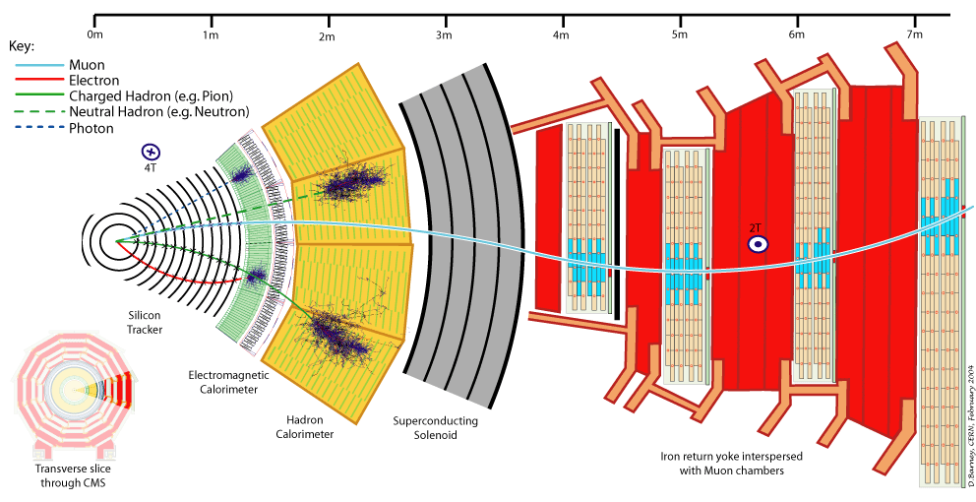
Slice through the CMS Detector

Slide 17
Outline
Introduction
Theoretical Overview
Experimental Apparatus
Datasets and Event Selection
Search Strategy
Background Estimation
Systematic Uncertainties
Results

Slide 18
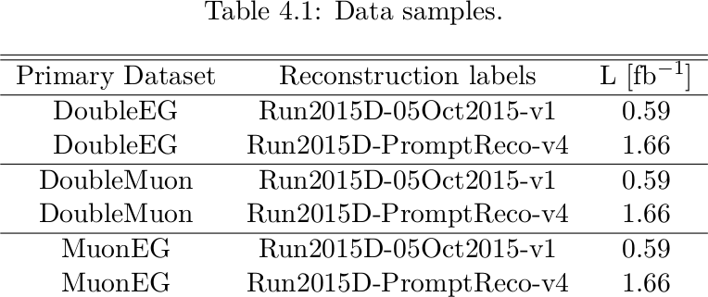
Data samples
Triggers, reconstruction periods, and integrated luminosity listed on the right
p_{T} (transverse momentum) thresholds:
DoubleEG: 17 GeV, 12 GeV
DoubleMuon: 17 GeV, 8 GeV
MuonEG: a) 17 GeV μ, 12 GeV e; b) 17 GeV e, 8 GeV μ

Slide 19
Object ID and Preselection
Selections:
Using standard object ID
electrons: p_{T} > 10 GeV, |η| < 2.5, non-triggering MVA (tight)
muons: p_{T} > 10 GeV, |η| < 2.4, medium ID
jets: p_{T} > 30 GeV, |η| < 2.4
Leptons are required to pass
20/15/10 GeV thresholds (to achieve trigger efficiency ~100%)
d_{z} < 0.1cm, d_{xy} < 0.05cm (rejecting leptons from heavy quark decays)
We reject events with an opposite-sign same-flavor (OSSF) lepton pair with an invariant mass below 12 GeV (low-mass resonances like J/Ψ, …)

Slide 20
Outline
Introduction
Theoretical Overview
Experimental Apparatus
Datasets and Event Selection
Search Strategy
Background Estimation
Systematic Uncertainties
Results

Slide 21
Search Strategy: Event Classification
Basics: require 3 or more light leptons
Apart from that: Don’t cut, but bin in certain event properties
Take advantage of the power of cuts (high signal-to-background ratio), but still make use of the rest of the data
Bin in the number of leptons
Bin in the number of opposite-sign same-flavor (OSSF) pairs
For events with an OSSF pair, categorize by its invariant mass (below/on/above Z window, which is 91±10 GeV)
Bin in L_{T} + MET (details later)

Slide 22
Signal Regions: Kinematic Binning
The signal populates regions with 3 or ≥ 4 leptons, both with or without OSSF pairs which may (or may not) be on Z
The transverse momentum sum (L_{T}) of the signal leptons is much higher than from standard model background, due to the higher parent particle masses (~400 GeV)
However, the amount of MET and the signal lepton p_{T}’s vary depending on the decay channel. Examples:
Σ± → l± Z → l± l’⁺l’– high lepton p_{T}’s, no MET
Σ⁰ → Hυ → WWυ lower lepton p_{T}’s, significant MET
The quantity L_{T} + MET covers both cases

Slide 23
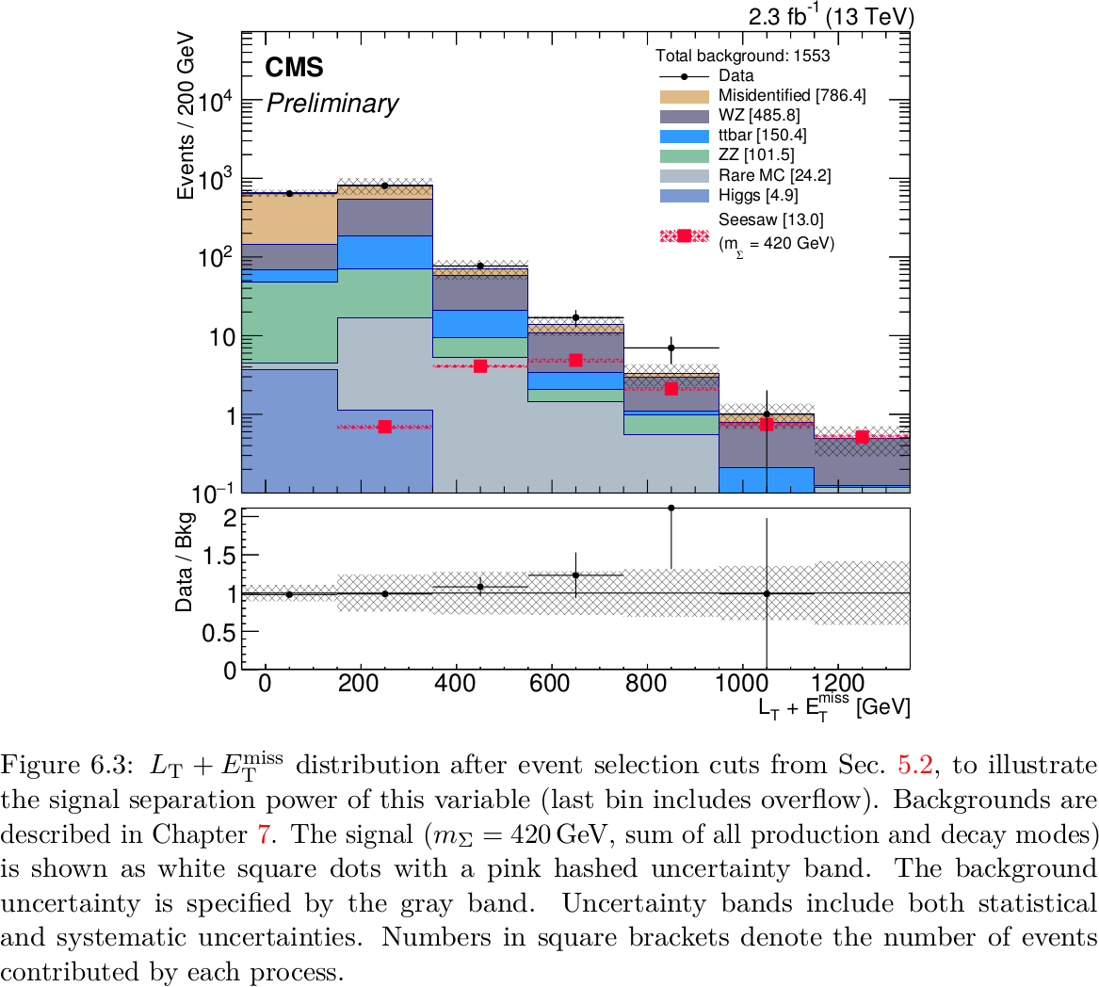
Signal Regions: Kinematic Binning

Slide 24
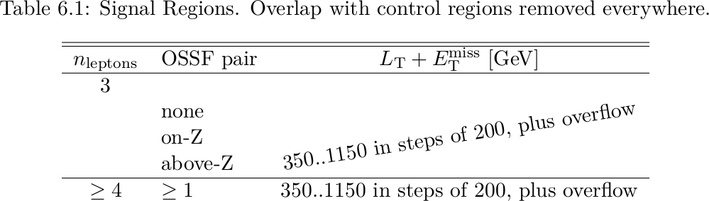
Signal Regions
This leads us to the following binning scheme (total: 20)
Overlap with background control regions is removed (details later)

Slide 25
Outline
Introduction
Theoretical Overview
Experimental Apparatus
Datasets and Event Selection
Search Strategy
Background Estimation
Systematic Uncertainties
Results

Slide 26
Background Estimation
Backgrounds in the top 10 most signal sensitive regions, by relative importance:
WZ → lll: about 51%
fully leptonic ttbar decays with a fake lepton from a b-jet: about 21%
Z → ll + fake lepton from a jet: about 17%
ZZ → 4l: about 3%
rare backgrounds (ttV, VVV, Higgs)
Most background estimates are data-driven / data-normalized
foundations of these methods come from Run I research

Slide 27
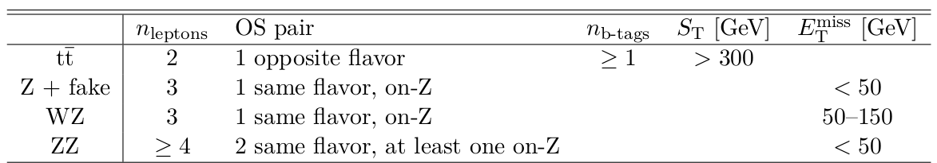
Background Estimation
General approach: WZ and ZZ are obtained from simulation, but normalized and weighted in data control regions where necessary
For fake processes (Z + fake, ttbar + fake), fake rates are measured in control regions
Z + fake fully data-driven
In ttbar, we use a data-driven fake rate with kinematics from MC

Slide 28
3L Background: WZ
Primary background: around 51%
WZ simulation is compared in M_{T} distribution for three leptons
Control region: 3L incl. OSSF pair on Z, 50 GeV < MET < 100 GeV
Normalization factor: 0.95 ± 0.07(stat)
No need for n_{jets} weights
Based on comparison with 100 GeV < MET < 150 GeV, we apply a systematic uncertainty of 50%

Slide 29
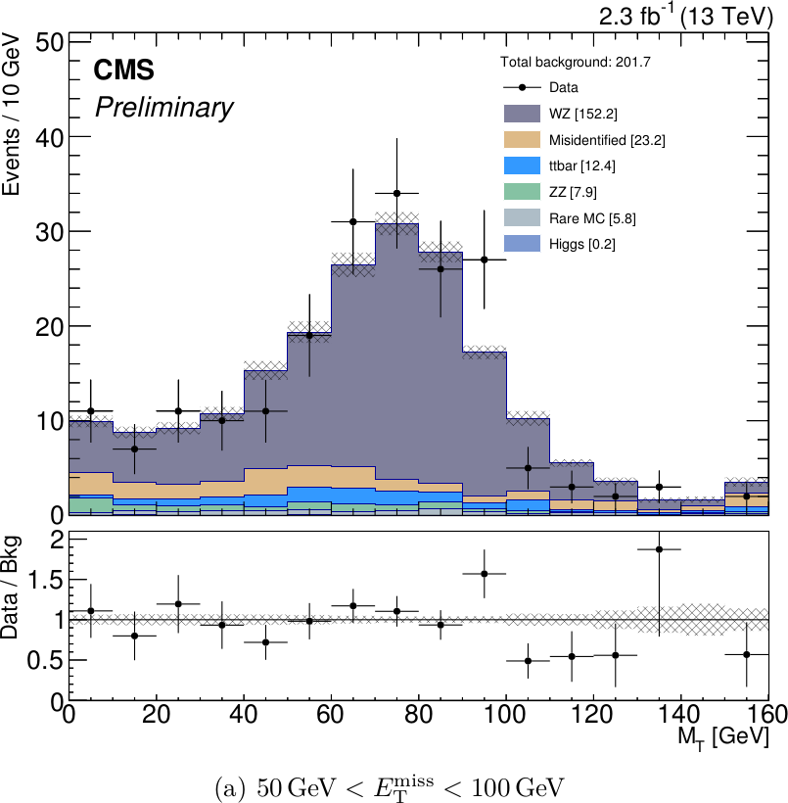
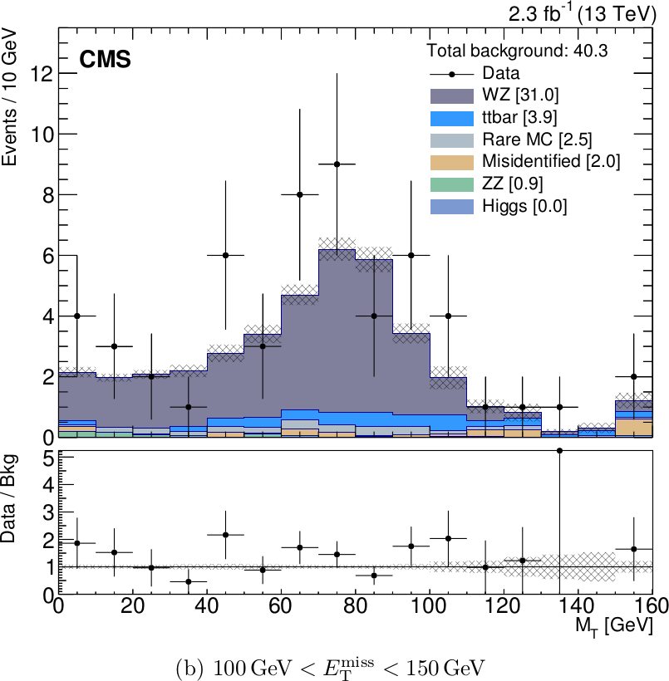
3L Background: WZ

Slide 30
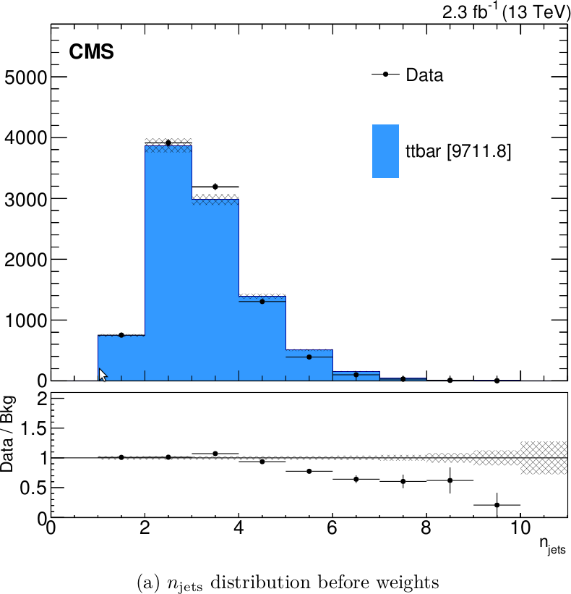
3L Background: ttbar (2L studies)
ttbar makes up about 21%
We rely on MC for process-specific kinematic properties
Therefore, we first make sure the simulation is reliable in dileptons
Normalization: 0.80 ± 0.01(stat)
We compare the n_{jets} distribution for dilepton events with an opposite-sign electron-muon pair and S_{T} > 300 GeV
apply n_{jets} weights

Slide 31
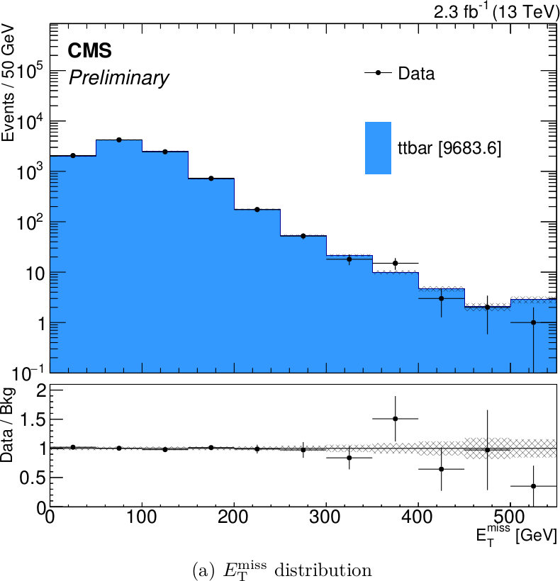
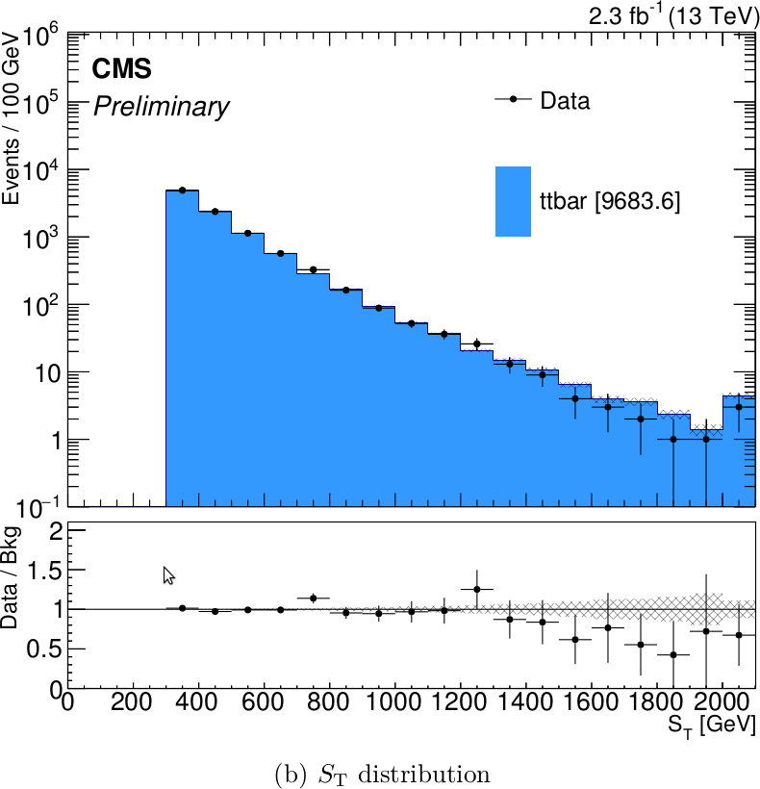
3L Background: ttbar (2L studies)
MET S_{T}

Slide 32
3L Background: ttbar (3L studies)
Having verified the validity of the MC kinematics, we compare the number of ttbar fake events in data and MC
Since the dilepton behavior has been validated, this amounts to comparing the fake rates in data and MC
For this purpose, we use semi-leptonic ttbar decays with a very tight lepton and an additional non-prompt (fake) lepton
We then scale the MC fake rate to match the one in data
This allows us to predict the correct number of fakes, with kinematics taken from MC
The scale factor is 1.5 ± 50%
systematic uncertainty based on statistical uncertainty, plus safety margin
impact on signal regions is < ~0.3 events

Slide 33
3L Background: Fake e/μ
Secondary background: about 17%
General idea: Use correlated objects (“proxies”) to predict the number of fake leptons
isolated tracks act as proxies for fake leptons from jets
photons act as proxies for fake leptons from photon conversion
Foundations of the method developed in 2010
scope of applicability has since then been improved
Control region: 3L with an OSSF pair, MET < 50 GeV
Fake rate is measured on Z and applied to dilepton events with presence of certain proxies
We subtract overlap from ttbar prediction

Slide 34
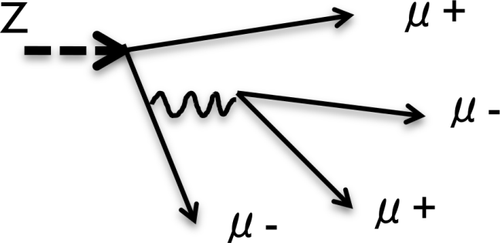
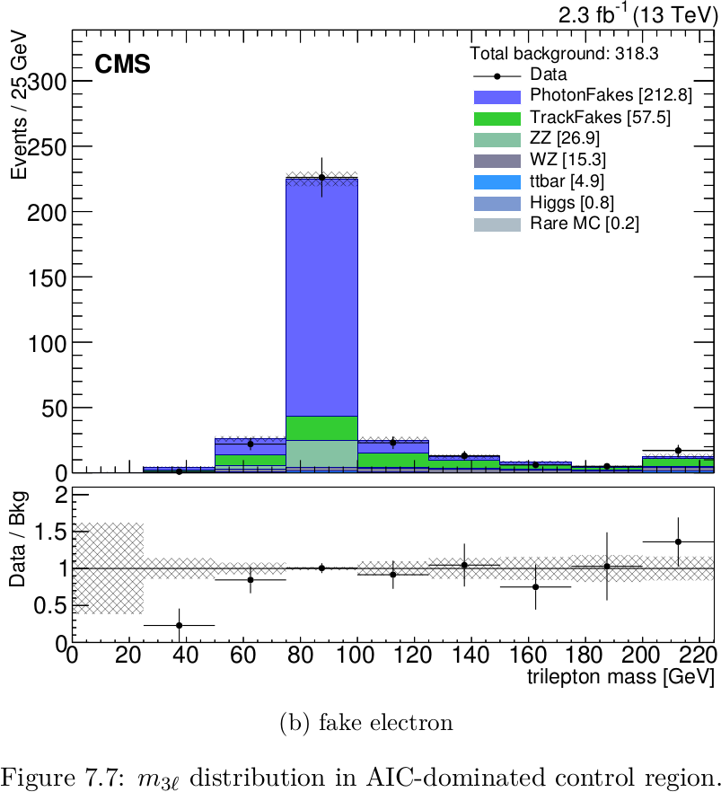
3L Background: AIC leptons
In internal conversions, the photon may decay asymmetrically (“AIC”)
One lepton is lost, the other is the fake lepton, carrying most of the momentum
In this case, the trilepton mass will be consistent with the Z mass (arXiv:1110.1368)
Control region: 3 leptons, MET < 50 GeV, H_{T} < 200 GeV, m_{OSSF} < 81 GeV, m_{3l} on Z
We use isolated photons as proxies for such fake leptons. Fake rates:
μ: 1.60% (ee environment), 1.05% (μμ environment)
e: 3.5% (ee environment), 4.5% (μμ environment)

Slide 35
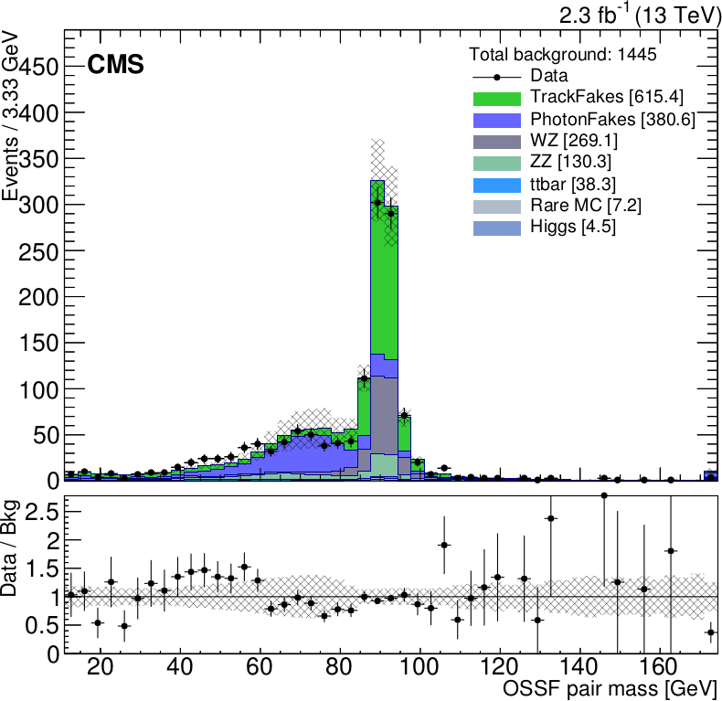
3L Background: Fake e/μ
We use isolated tracks as proxies for prompt fake leptons from jets, normalized around Z
Control region: 3L with OSSF pair on Z, MET < 50 GeV
Fake rates:
electrons: (1.59 ± 0.15(stat)) %
muons: (1.49 ± 0.13(stat)) %
Systematic uncertainty of 14% based on variation as a function of the flavor of remaining prompt lepton pair
Closure + validation plots in extra slides
Track fakes
AIC fakes

Slide 36
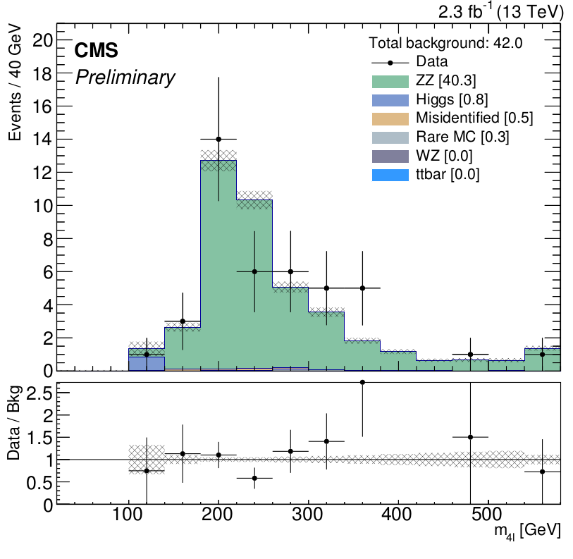
4L Background: ZZ
ZZ makes up about 3%
We compare the MC simulation in the four-lepton invariant mass distribution
Control region: 4L incl. 2 OSSF pair (at least one on Z), MET < 50 GeV
Normalization factor: 1.38 ± 0.23(stat)
17% systematic uncertainty from control region size

Slide 37
Outline
Introduction
Theoretical Overview
Experimental Apparatus
Datasets and Event Selection
Search Strategy
Background Estimation
Systematic Uncertainties
Results

Slide 38
Systematic Uncertainties
Almost all our signal regions are limited by statistics
Statistical uncertainties are usually large
Systematic uncertainties play a minor role
Exception: 3 leptons with an OSSF pair on Z
WZ-dominated
The WZ normalization uncertainty is relevant
Other systematic uncertainties are still applied
Correlations and anti-correlations are taken into account
Detailed list on next slide

Slide 39
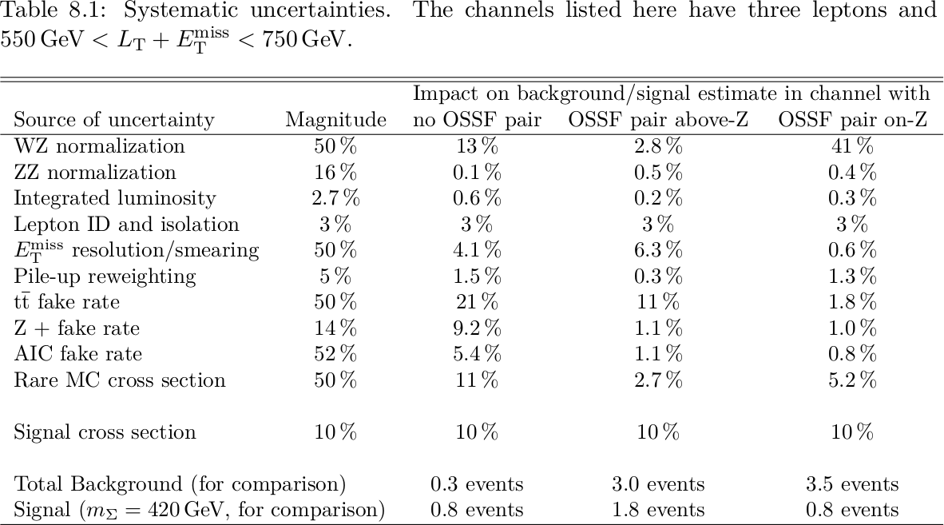
Systematic Uncertainties

Slide 40
Outline
Introduction
Theoretical Overview
Experimental Apparatus
Datasets and Event Selection
Search Strategy
Background Estimation
Systematic Uncertainties
Results

Slide 41
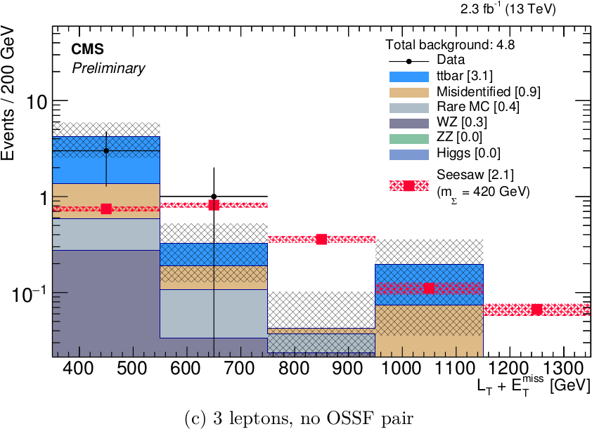
Results
3 leptons, no OSSF pair
Signal value and uncertainty at the m_{Σ} = 420 GeV point are shown on top of background breakdown
Signal uncertainties displayed as red hashed band
Includes both statistical and systematic uncertainties
Rank 9
Rank 2
Rank 6

Slide 42
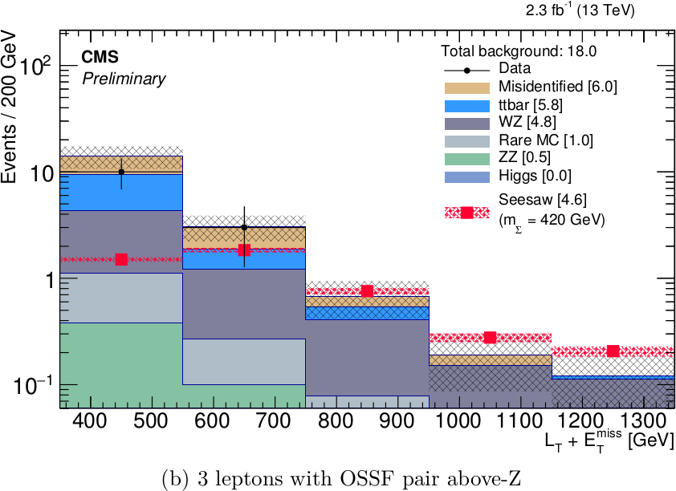
Results
3 leptons, OSSF pair above Z
Rank 7
Rank 1
Rank 3
Rank 10

Slide 43
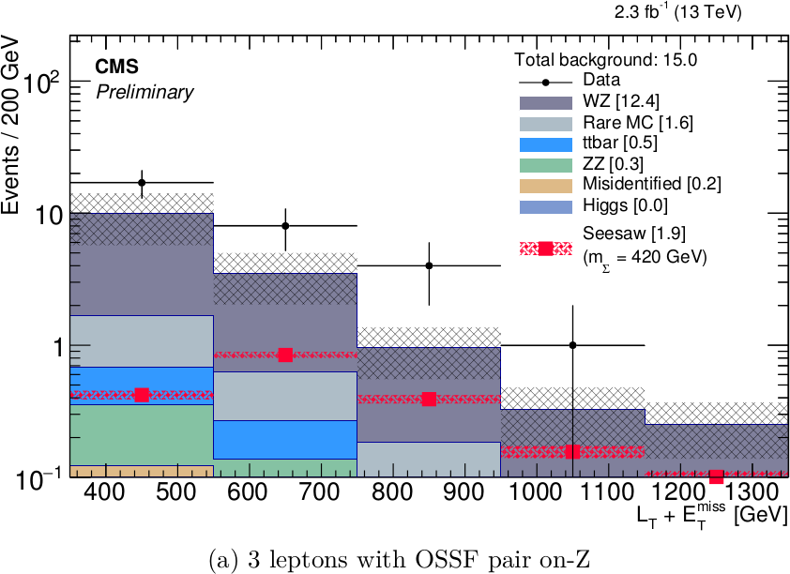
Results
3 leptons, OSSF pair on Z
observation: 17, 8, 4, 1
these events have MET > 150 GeV
At MET < 100 GeV, the WZ agreement is fine
this is the control region, free of signal
Above 100 GeV, the WZ prediction does not agree as well with the data
Does not impact limits significantly
Rank 8

Slide 44
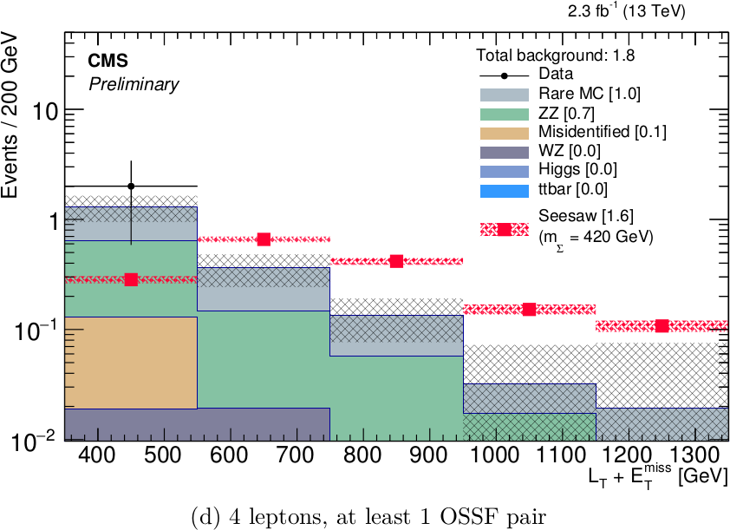
Results
4 leptons, ≥ 1 OSSF pair
Rank 4
Rank 5

Slide 45
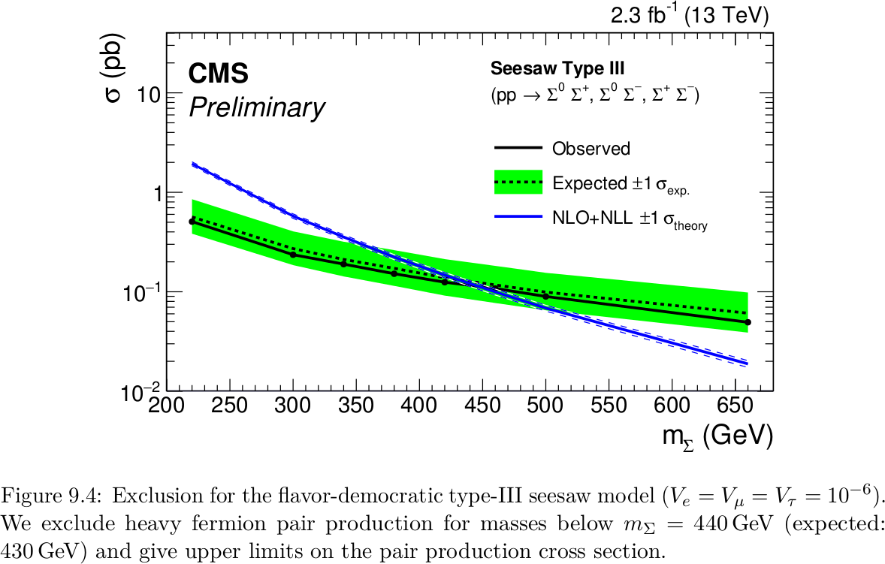
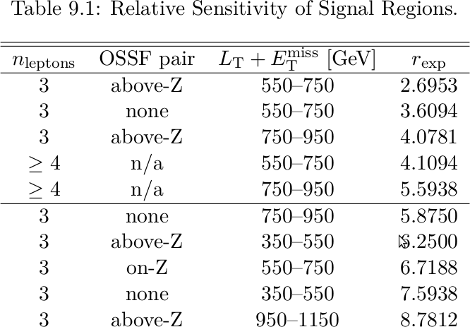
Seesaw Results: CL_{s} limits
We compute 95% CL_{s} exclusion limits on the signal cross-section

Slide 46
Conclusion
We conducted a search for Type-III seesaw signal in multilepton final states
Our sensitivity exceeds that of Run I
No evidence of seesaw signal has been observed
Exclusion limits were derived from the results
We exclude the signal hypothesis for heavy fermion masses m_{Σ} < 440 GeV

Slide 47
Thanks!
A big thanks to …
My Ph. D. committee
The Rutgers multilepton group
high energy theorist Scott Thomas
our postdocs R. C. Gray, M. Walker, H. Saka
my fellow grad students S. Arora, C. & E. Contreras-Campaña, M. Heindl, S. Panwalkar, P. Zywicki
as well as to K. Feigelis

Slide 48
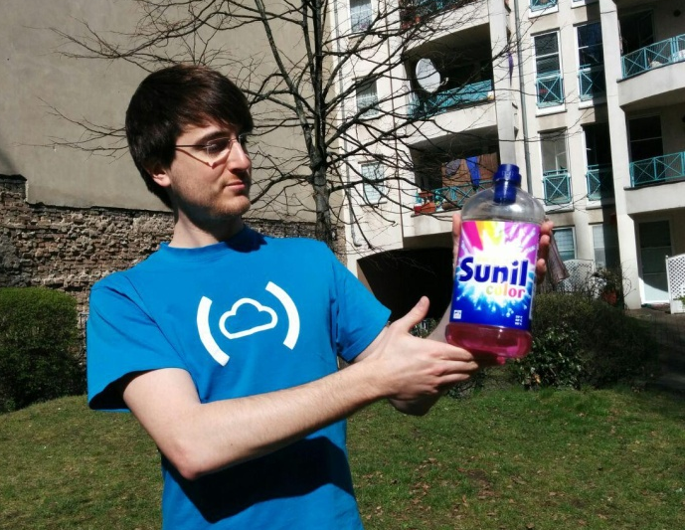
Thanks!
A big thanks to …
My Ph. D. committee
The Rutgers multilepton group
high energy theorist Scott Thomas
our postdocs R. C. Gray, M. Walker, H. Saka
my fellow grad students S. Arora, C. & E. Contreras-Campaña, M. Heindl, S. Panwalkar, P. Zywicki
as well as to K. Feigelis
My supervisor Sunil Somalwar

Slide 49
Extra Slides

Slide 50
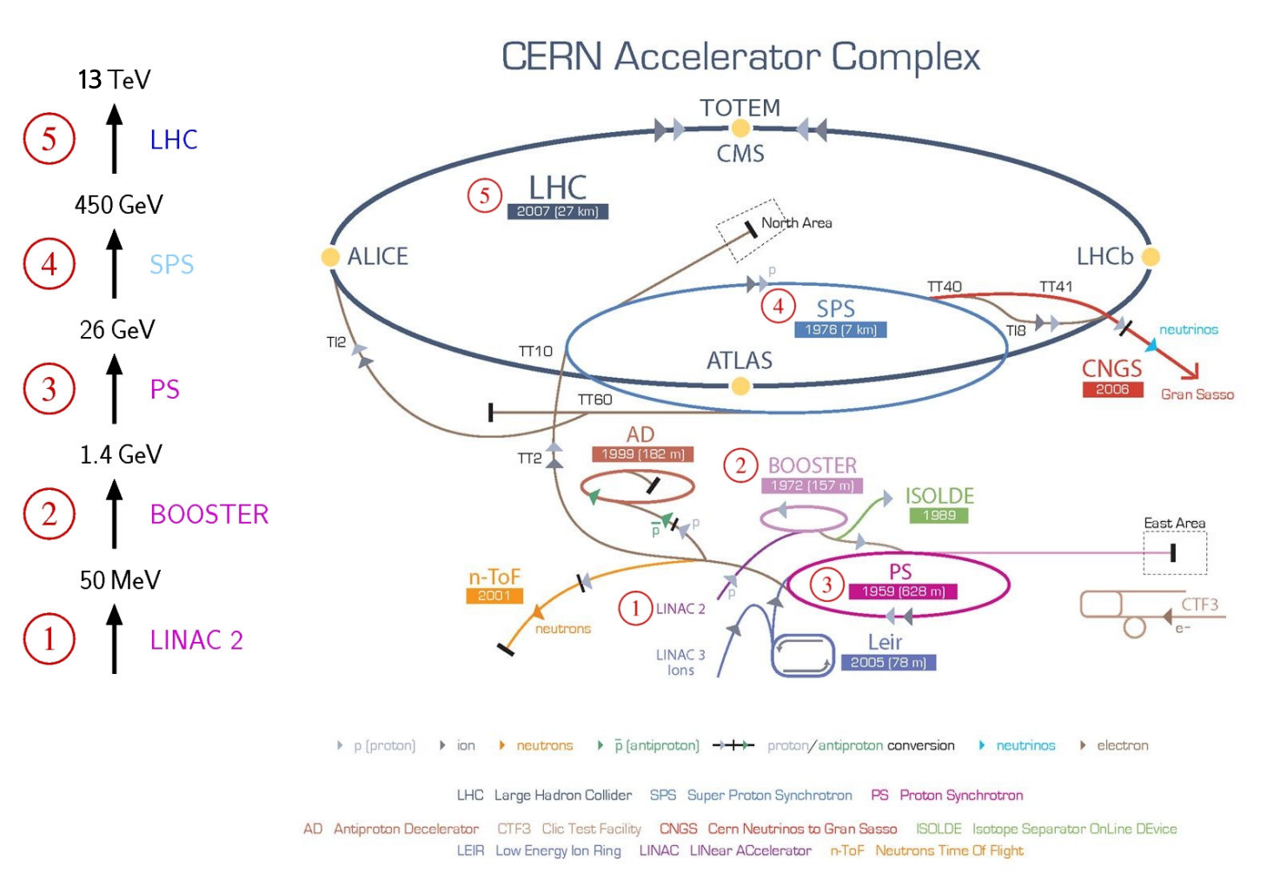
LHC in the Accelerator Complex

Slide 51
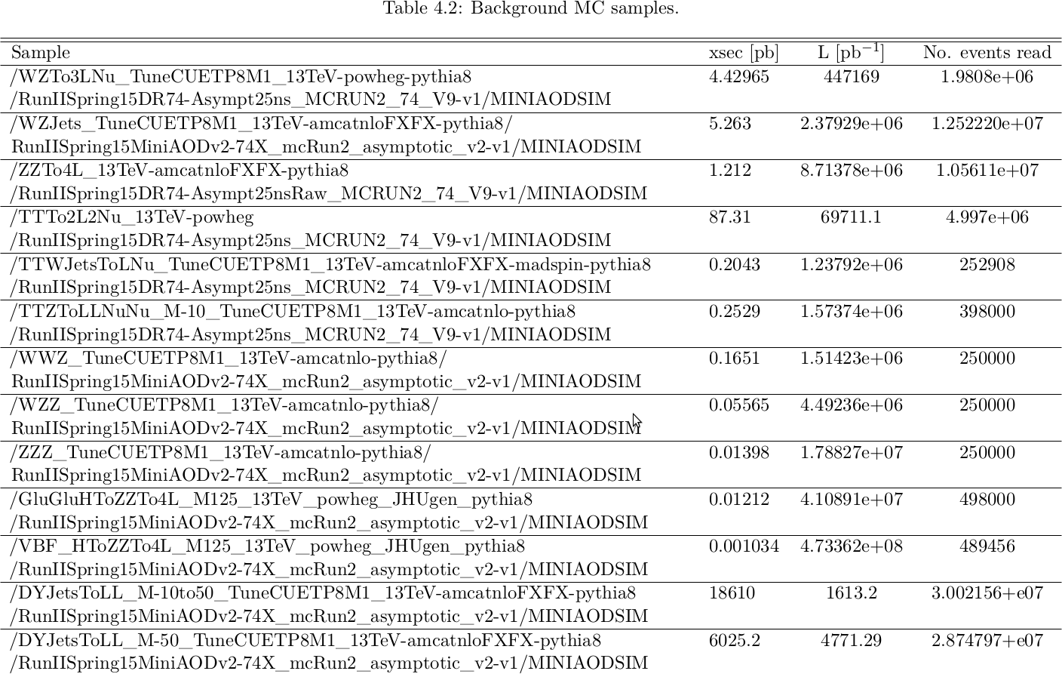
Background MC samples

Slide 52
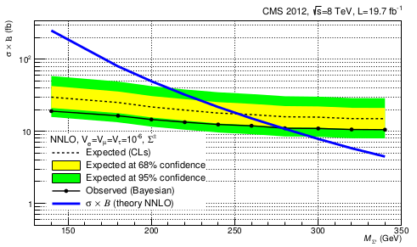
Comparison to Run I Result
EXO-14-001 PAS (Padova)
Generated 3L final states based on Σ± → W±υ, Σ± → Z l±, Σ⁰ → W±l± processes
Selection:
MET > 50 GeV, H_{T} < 150 GeV, b-tag veto, Z veto, AIC veto
lepton p_{T}’s > 30, 20, 20 GeV and charge sum binning
Limits placed on σ∙BR
now: limits on σ only (less analysis-specific approach)
M_{Σ} limit placed at 278 GeV observed, ~250 GeV expected

Slide 53
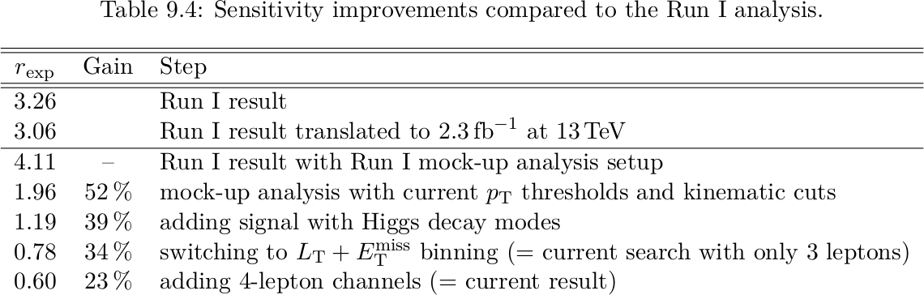
Details of Improvements after Run I
We take the Run I result r_{exp}(340 GeV) = 3.26 and transform it for comparability
remove the k-factor, apply xsec scaling and √(19.5/2.3)
thus, the Run I analysis would achieve r_{exp} = ~3.06 with the current amount of 13 TeV data
We repeat the Run I analysis approximately and obtain r_{exp} = 4.11
Difference of 34% (comparable to uncertainty of the result) is in the conservative direction, and due to the approximations and binning differences in the mock-up analysis
We then add improvements step by step

Slide 54
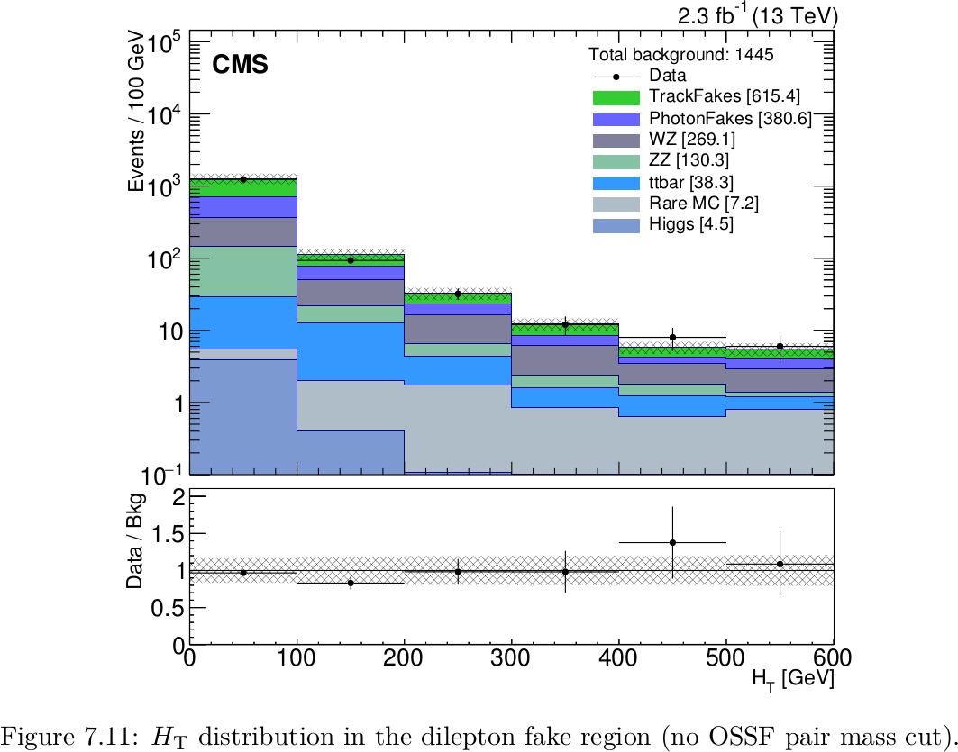
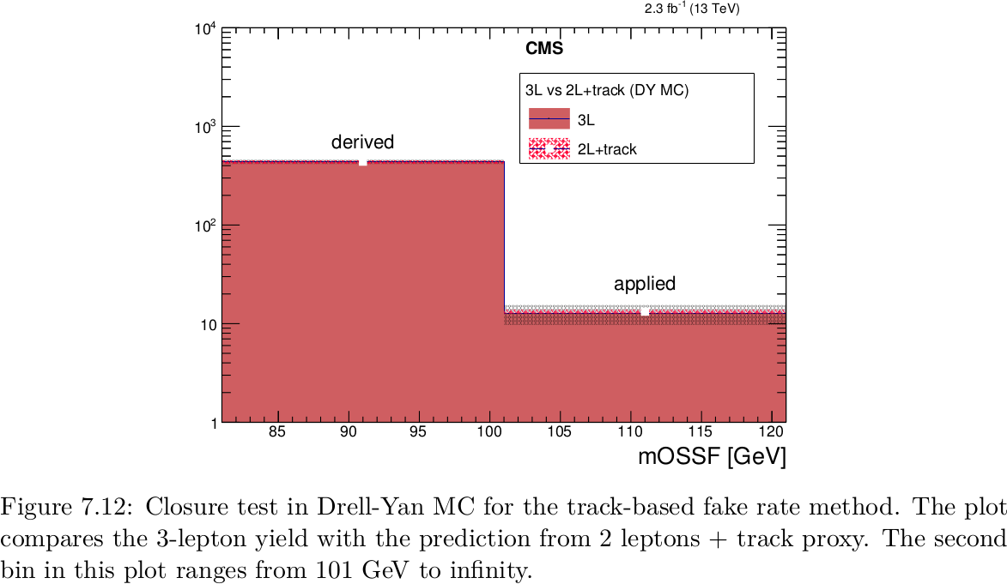
3L Background: Fake e/μ
Verify that method works in data and MC
H_{T} in control region MC closure test

Slide 55
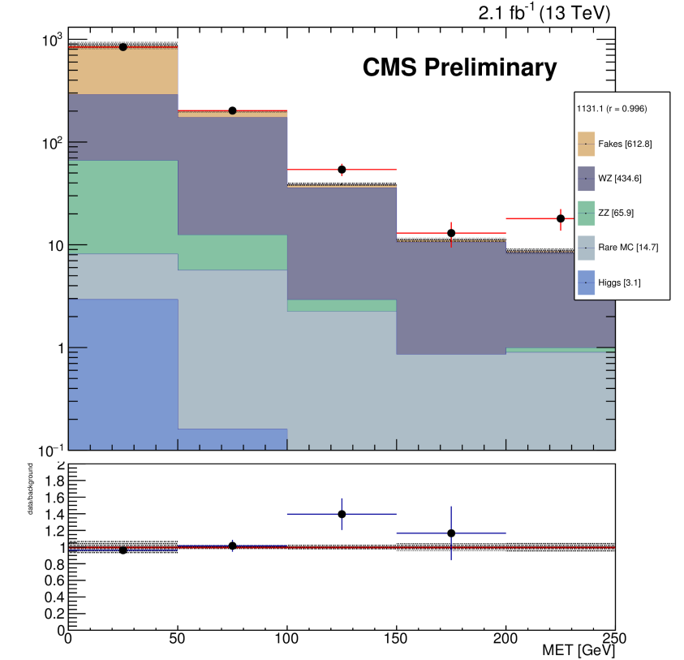
WZ Investigations
There seems to be a discrepancy in the region with 3 e/μ and MET > 100 GeV
We tried various MC samples, but the problem remains
WZTo3LNu (Powheg)
WZJets (amcatnlo)
MET distribution for 3 light leptons, with OSSF pair on Z

Slide 56
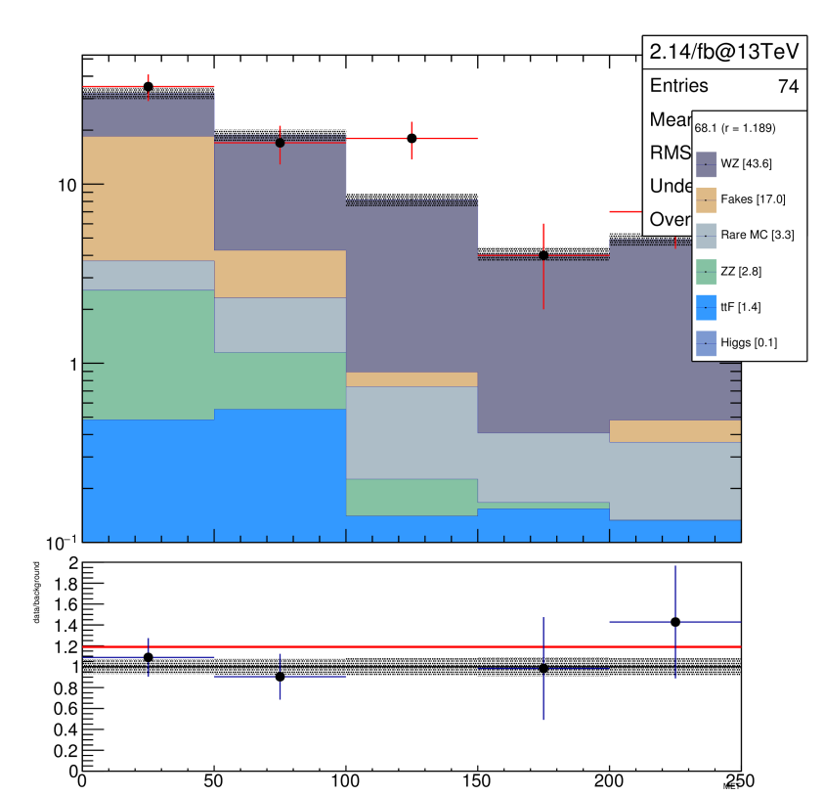
WZ Investigations
We see a discrepancy in the region with 3 e/μ and MET > 100 GeV
At H_{T} > 200 GeV and with b-veto, the significance increases from roughly 2 sigma to roughly 3 sigma
We want to put out a specific Seesaw result. Normally we put out big multilepton tables with all kinds of binning.
However, we don't think that the 2015 data is large enough / has been sufficiently digested (e.g. state of the MC's) for such a result. However the Seesaw result itself is quite robust.

Slide 57
Seesaw at 13 TeV
In the previous CMS result, some decay processes (like 4L modes) were not considered
In total, there are 27 processes to be considered
We produced all 27 processes
So far only private production for a few points
Generation scheme: Model file (Biggio and Bonnet) → FeynRules → UFO file → MadGraph → LHE (W/Z/H undecayed) → Pythia8 (all decays & hadronization) → trilepton filter → CMS simulation
Next step: Official MC signal generation
100k events per process
Triplet masses in range 140–660 GeV
Official samples are being requested
Following results are from privately produced MC test points

Slide 58
FeynRules and Model
Input is a model file which includes model-specific Lagrangians and particle parameters
Runs as a Mathematica package that calculates decay widths, vertices, Feynman rules
Outputs a “UFO” model directory which may be imported for usage with an MC generator
MadGraph is used in the following
FeynRules model file with neutrino mass via Type III Seesaw was created by C. Biggio, and F. Bonnet

Slide 59
Event Generation with MadGraph
Takes FeynRules UFO directory as input
Generates events, and all relevant Feynman diagrams for each process
Allows for some general kinematic parameter tuning
Beam energies, polarization, p_{T} cuts, jet cuts
Outputs LHE formatted event files

Slide 60
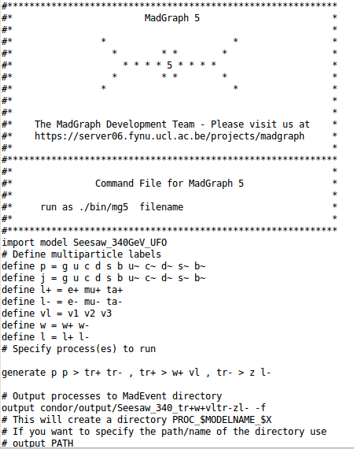
Event Generation with MadGraph (II)
Started with privately generated sample
25k events per process, per mass point
Currently we have 340, 220 GeV points
All 27 total processes evaluated per mass
Relevant σ*BR extracted from in LHE files
Decay chains are specified in proc cards
Decay product kinematic constraints are relaxed in run cards
Processes all end at bosonic level – to be decayed in Pythia8

Slide 61
Filtering and Hadronization
Use Pythia8 for Hadronization and further decays
MCMultiParticleFilter is used to remove all generated events which do not pass the following criteria:
Final state with three or more leptons possible
Each with a minimum p_{T} of 4 GeV
Light leptons must have status 1, taus must have status 2

Slide 62
Filtering and Hadronization (II)
Pythia picks up the leftovers from the particle filter
After Pythia runs, relevant cross sections for both before and after filter are available, as well as filter efficiencies
These filter efficiencies are then used in the analysis step to reweight signals to real luminosities

Slide 63
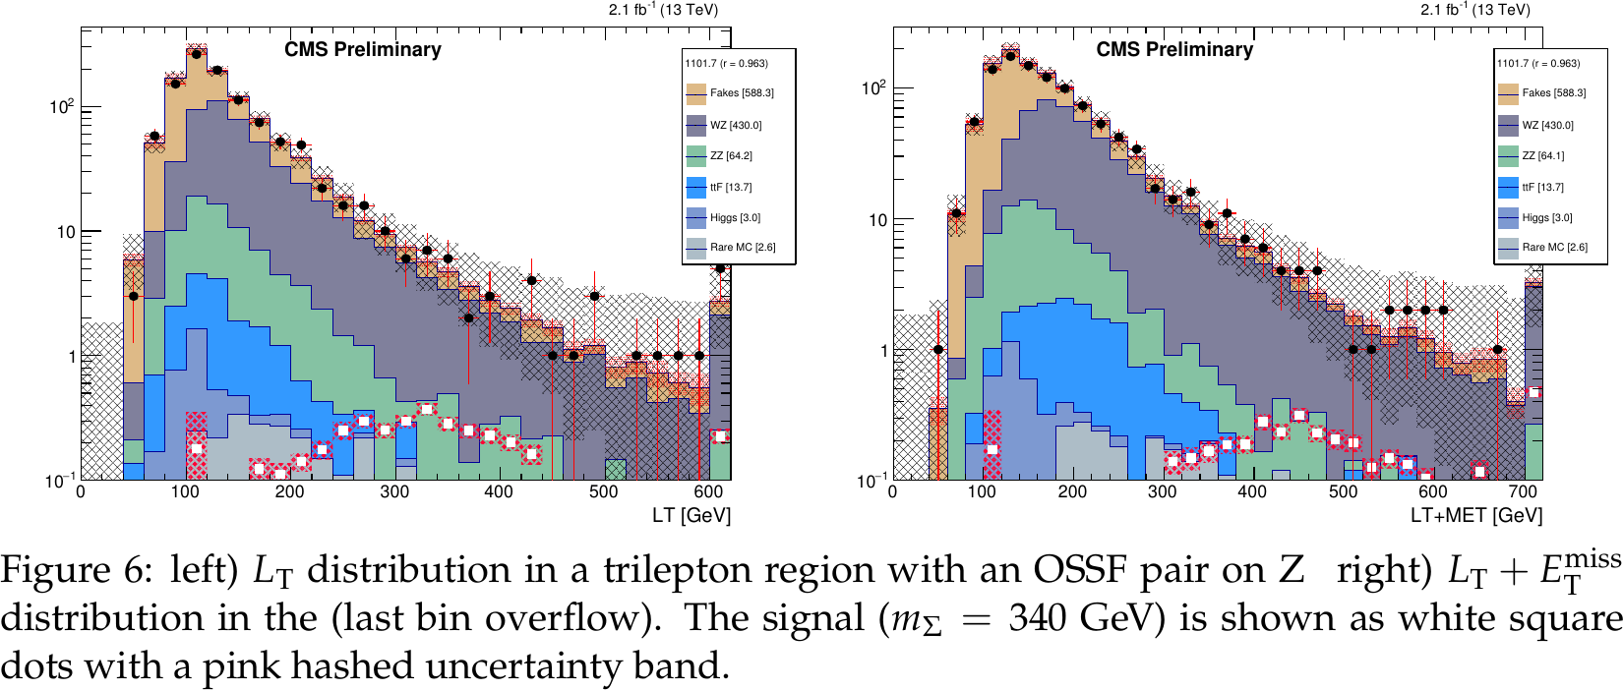
Signal Regions: Kinematic Binning
Comparing L_{T} (left) and L_{T} + MET (right)

